Slide 1

BATCH:43
Project Title:
“Clustering‑Based Crime Pattern Analysis”
GUIDE: Dr. Prashant Upadhyay
221FA04108(K.Nikhil)
221FA04135(M.Srilatha)

Slide 2
Motivation
Crime is a major social problem affecting public safety and quality of life.
Large volumes of crime data are generated daily by law enforcement agencies.
Manual analysis of crime data is time‑consuming and inefficient.
Traditional methods fail to identify hidden spatial and temporal crime patterns.
There is a need for an automated data‑driven system to identify crime hotspots.
Goal
To analyze crime data using clustering techniques and identify meaningful crime patterns that support preventive policing.

Slide 3
Problem Statement
Despite the availability of large-scale crime datasets, existing crime analysis approaches rely heavily on manual reporting and basic statistical methods. These methods are ineffective in discovering hidden spatial and temporal patterns in crime data. Additionally, many existing systems do not handle noisy and unlabeled crime data efficiently. Therefore, there is a need to develop an automated clustering‑based system that can analyze crime data and identify crime hotspots and patterns to assist law enforcement decision‑making.

Slide 4
Introduction
Crime pattern analysis plays a crucial role in maintaining public safety. With increasing urbanization, crime data has become complex, large, and multi‑dimensional. Machine learning techniques, particularly unsupervised clustering, provide an effective solution for analyzing such data.
This project focuses on applying clustering algorithms such as K‑Means and DBSCAN to group similar crime incidents based on location and time, enabling the identification of crime hotspots and trends.

Slide 5
Literature Survey
Paper Group 1: Traditional Clustering
Methods: K‑Means, Hierarchical Clustering
Used for: Crime hotspot identification using spatial data
Pros:
• Simple and fast
• Easy to interpret
• Works well on large datasets
Cons:
• Requires predefined number of clusters
• Sensitive to noise and outliers
Paper Group 2: Density‑Based Clustering
Methods: DBSCAN, OPTICS
Used for: Detecting dense and irregular crime regions
Pros:
• No need to specify number of clusters
• Handles noise effectively
• Detects arbitrary‑shaped hotspots
Cons:
• Sensitive to parameter selection
• Performance reduces with varying density
LINK - https://docs.google.com/document/d/1ikq1sAPQuog70ICcOQleV3QDxH09cVJ0IP0zrqF7kJM/edit?usp=sharing

Slide 6
Overall Analysis and Research Gap
From the literature survey, it is observed that:
K‑Means is efficient but sensitive to noise
DBSCAN handles noise but struggles with varying densities
Most studies focus on either spatial or temporal analysis
Research Gap
There is a need for a hybrid clustering‑based approach that combines spatial and temporal analysis while handling noise effectively. This gap is addressed in the proposed project Clustering‑Based Crime Pattern Analysis.

Slide 7
Dataset
Attributes
Crime Type
Date and Time
Latitude
Longitude
Location Details
Dataset https://www.kaggle.com/code/jockeroika/crime-analysis
Dataset Type:
Structured crime records (spatial and temporal data)
Dataset size:
1.05 million real‑world crime records containing spatial (latitude, longitude) and temporal features

Slide 8
Objectives
To analyse crime data using clustering techniques.
To identify crime hotspots based on location.
To discover hidden crime patterns without labelled data.
To visualize crime clusters for better interpretation.
To support data‑driven crime prevention strategies.

Slide 9
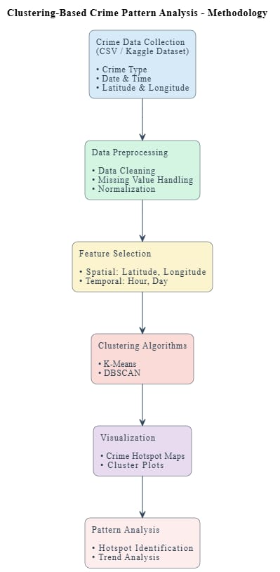
Basic Methodology
Crime data collection
Data preprocessing and cleaning
Feature selection (location and time)
Clustering using K‑Means and DBSCAN
Visualization of crime hotspots
Pattern analysis and interpretation

Slide 10
Software Requirements
Component | Requirement
Operating System | Windows / Linux
Programming Language | Python 3.x
Development Environment | Google Colab / VS Code
Libraries | Pandas, NumPy, Scikit‑learn, Matplotlib, Seaborn

Slide 11
Hardware Requirements
Component | Requirement
Processor | Intel i5 or equivalent
RAM | Minimum 8 GB
Storage | 10–20 GB free space
Internet | Required for dataset access

Slide 12
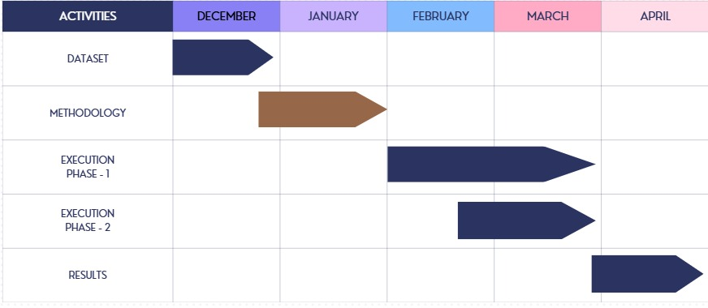
GANTT CHART

Slide 13
GITHUB REPOSITORY
https://github.com/221FA04108/Crime-Pattern-Analysis

Slide 14
Thank You

